Slide 1
SALES KNOWLEDGE
CLIENT CATEGORY

Slide 2
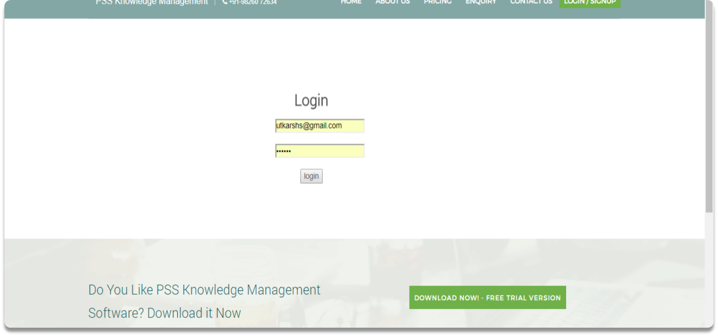
Login as organization employee or as organization admin

Slide 3
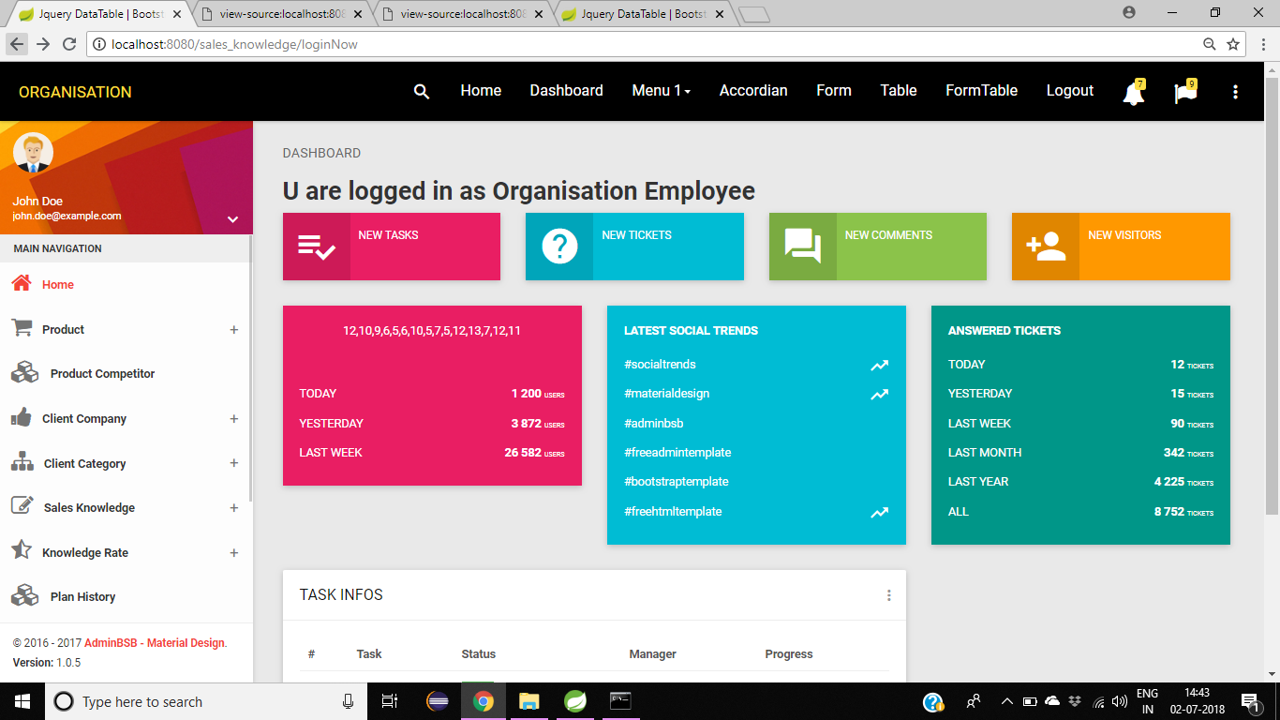
Home page

Slide 4
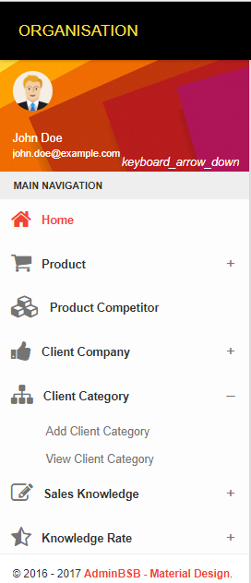
Select option from sidebar-
“Add Client Category”

